Slide 1
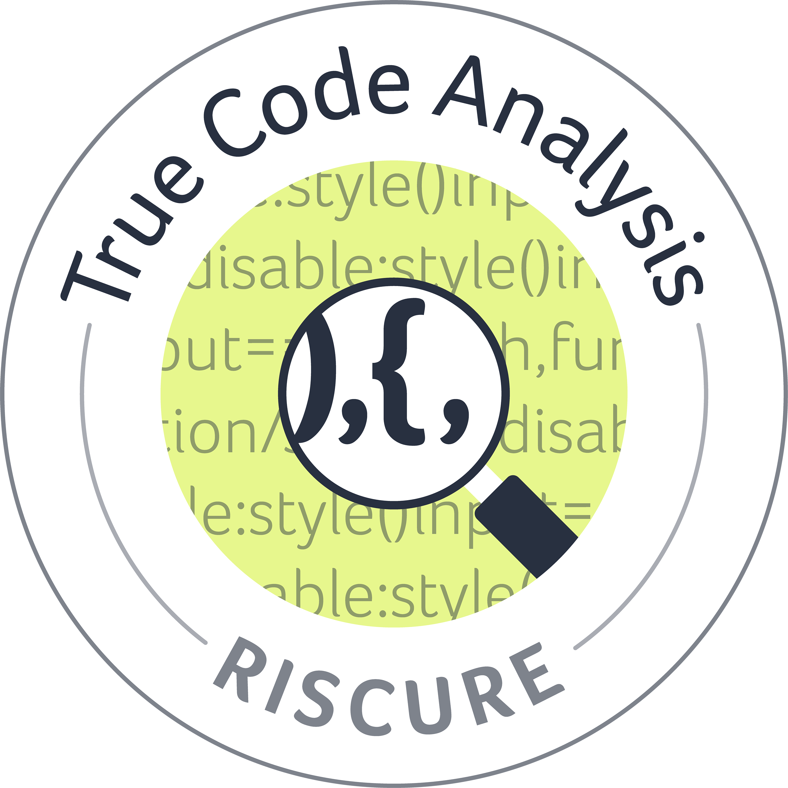
True Code
Efficiency through collaboration
& automation

Slide 2


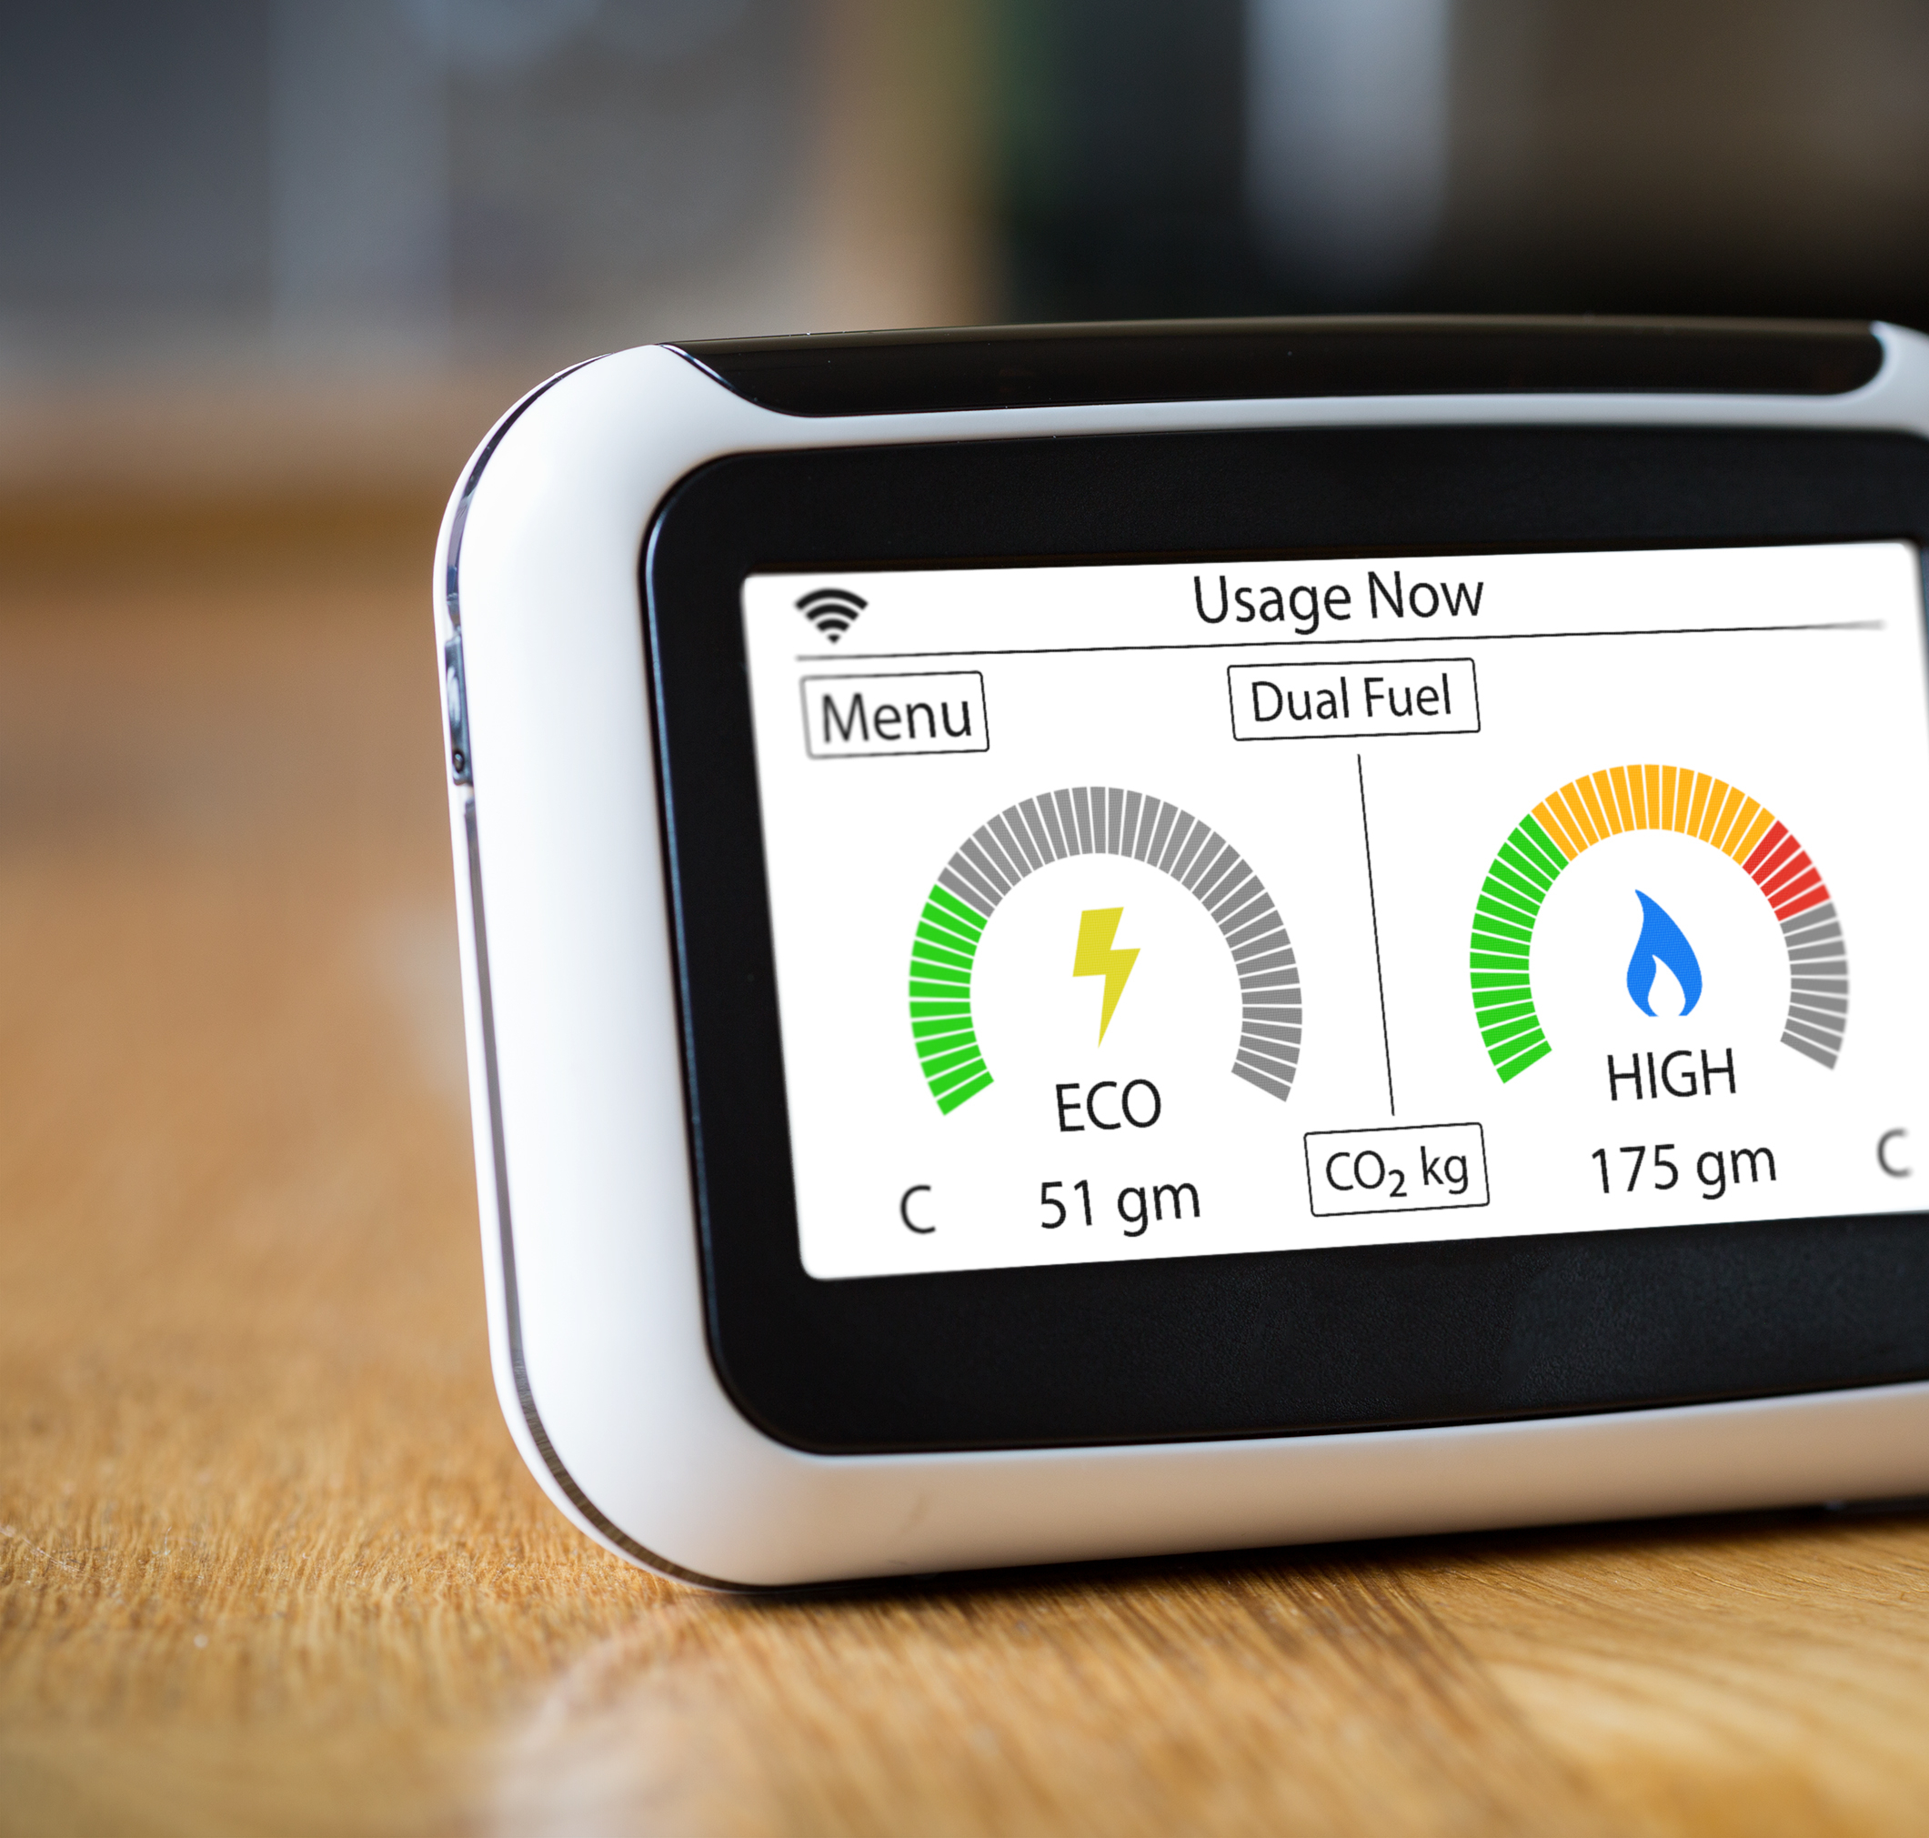
Why we started it
Security vulnerabilities in software have led to numerous exploits in the last years. The fact that the size of software running on devices is becoming bigger and bigger as well as the number of use cases that need to be supported only makes it more likely that future exploits will increase.
To prevent hacks that bring down customer thrust, can cause revenue loss because of piracy and are costly to mitigate after product releases, software need to be evaluated.
Up until know this evaluation process is a highly manual task which results in high costs and long lead times. It is also quit common that an evaluation takes place at the end of the development cycle causing higher costs to resolve issues opposed to when issue would have been found in the development phase.

Slide 3
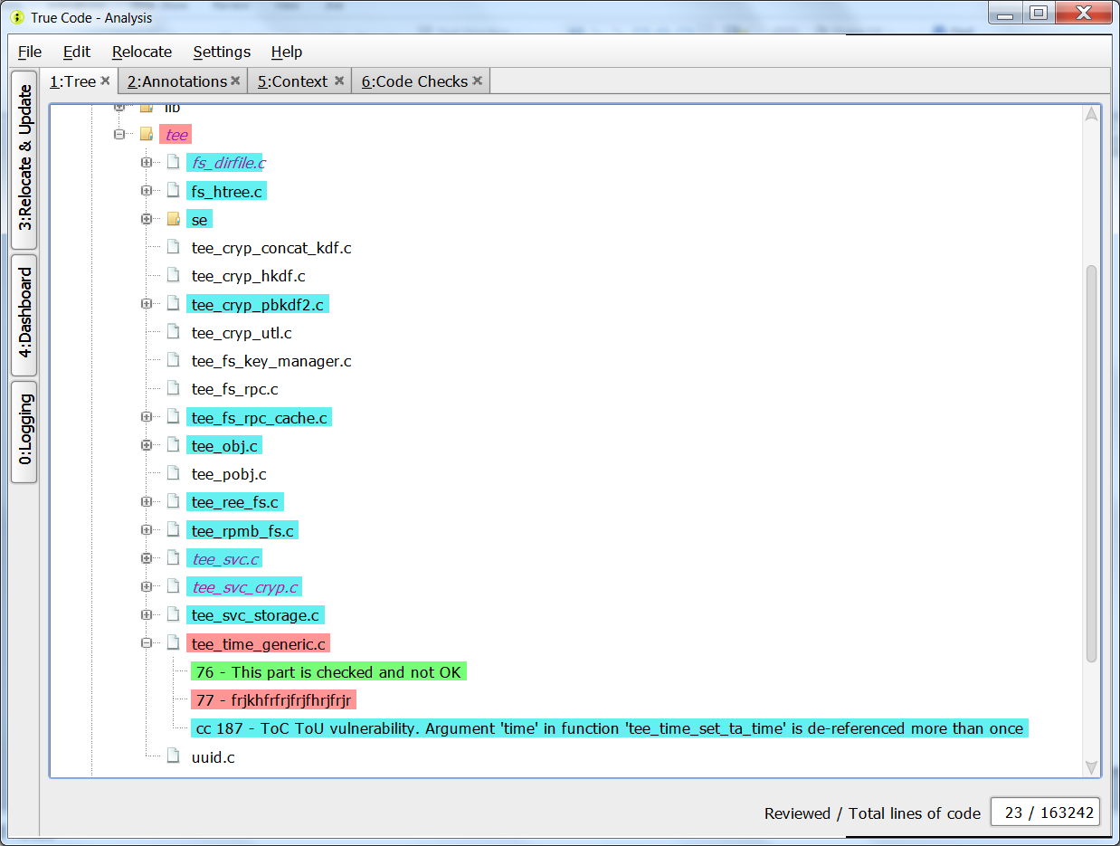
The product
We developed True Code.
A tool purely focused on finding security vulnerabilities in source code and enabling natural collaboration between security evaluators and the development team to discover vulnerabilities as early as possible and boost efficiency to resolve issues.
Safe costs by finding vulnerabilities early in the development process and solve issues in the most efficient way
Combine manual and automated reviews
Easy integration in your software development lifecycle
Security experts and developers both work in the same environment
Integrated in Eclipse or stand-alone to use with any IDE of choice

Slide 4
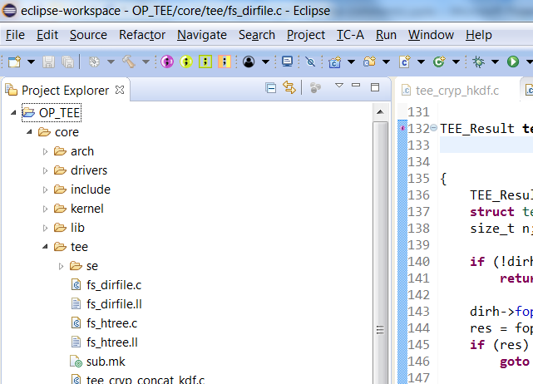
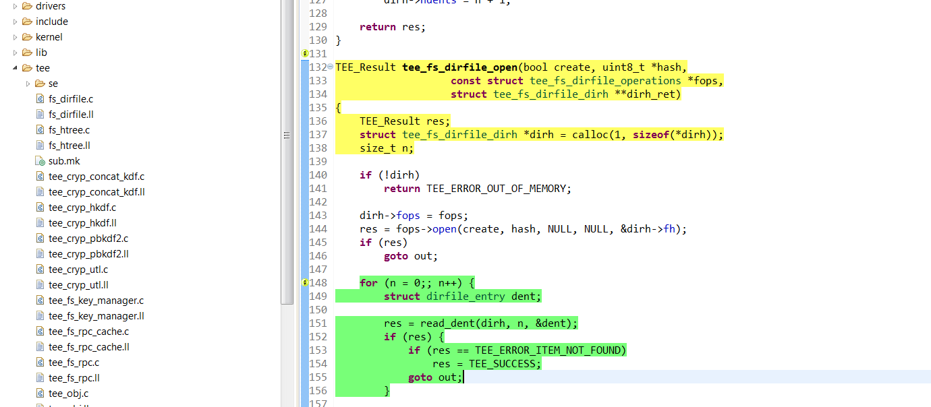
True code options easily available and integrated in the IDE
The challenges it solves
Safe time and costs
Finding vulnerabilities and issues during the development phase and immediately resolving them can be up to a 100 times cheaper compared to doing the same later in the process. True Code brings this promise within reach through a tight integration in the development, sharing found vulnerabilities instantly with all team members. True code integrates tightly with the development environment that is used by your team and integrates with any other SLD tools to automate as much as possible
Combine expert knowledge and automation
Expert knowledge is needed to find vulnerabilities in a code base. We have used years of experience obtained during manual code reviews to strengthen the automated vulnerability finding capabilities of True Code so that it find ‘real’ issues instead of false positives.
Next to that we strongly believe that to achieve the highest level of security a combination of automated checks and expert manual code review gives the best results. In order to achieve this, both kind of checks are done from the same platform and this is also the platform used by the developers. Encouraging collaboration between all teams working together in delivering the product.
Color schemes help to easily identify different types of found vulnerabilities for everyone in the team

Slide 5
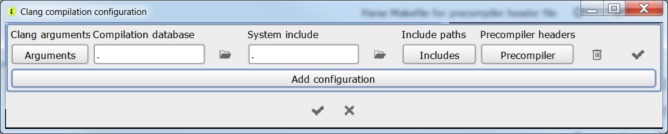
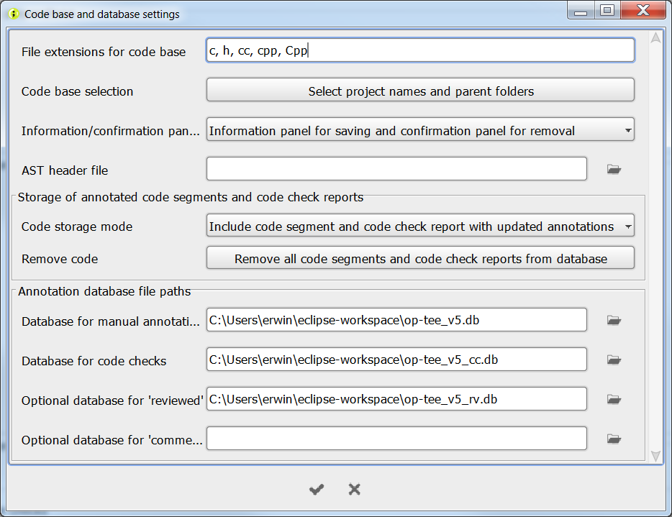
Setting op prerequisites for compilation needed for the automated checks is easy and straight forward
The challenges it solves
Easy to configure
Setting up and configuring a code analysis tool can be a real burden for a development team. We have made this a smooth a possible, guaranteeing a minimal amount of effort to get started and a steep learning curve for the users.
To run the automated code checks, True code will need to compile your sources, but to direct True Code in executing this compilation step providing a compilation database is sufficient. To start working with the collaboration features: choose your database , configure True Code to make use of this and you are good to go!
Context driven to reduce false positives
Context is a center point in True Code. For Efficient checking of security vulnerabilities context, basically a way to flag certain parts of your code base, is necessary. True Code allows you to define as much context as you need and has a rule based system to help you.
After context definition you can choose to run a code check on 1 specific context, all defined context or a subset.
Set your code base to start working with True Code
Choose the database that you want to choose for storing found vulnerabilities

Slide 6
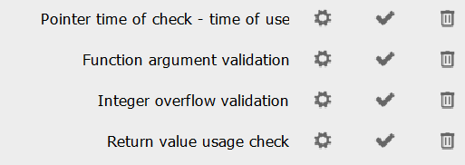
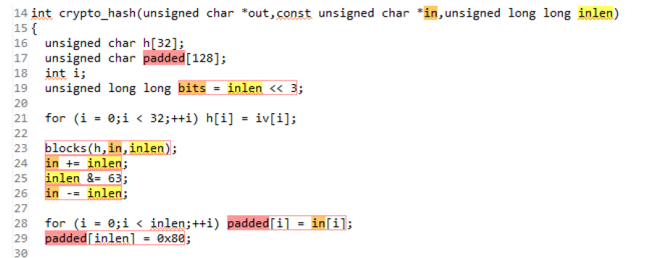
Each code check can have it’s own specific configuration making sure that the check runs as efficient as possible
The challenges it solves
Enabling ‘live code reviews’
Manual code reviews are usually planned at the end of the development process. This means that solving found issues will be done long after the problem was introduced. True Code solves this issue by supporting ‘live reviews’. In this way, the evaluation team can work along with the development team while True Code helps keeping an overview which parts of the code have been reviewed and where the development team have made changes. This will make sure that the development team as well as the evaluation team both work as efficient as possible with savings up to 30%
Make extensive reporting obsolete
Reporting can consume a lot of time from the evaluation team. That’s why True Code keeps track of all issues and progress with regard to solving them in a database. Obviously this database can be queried with any SQL tool available, but True Code also has an option to generate a report based in database content. This saves valuable time from the evaluation team that instead can focus on security issues.
Dataflow visualization helps to more easily identify security vulnerabilities when manually checking

Slide 7
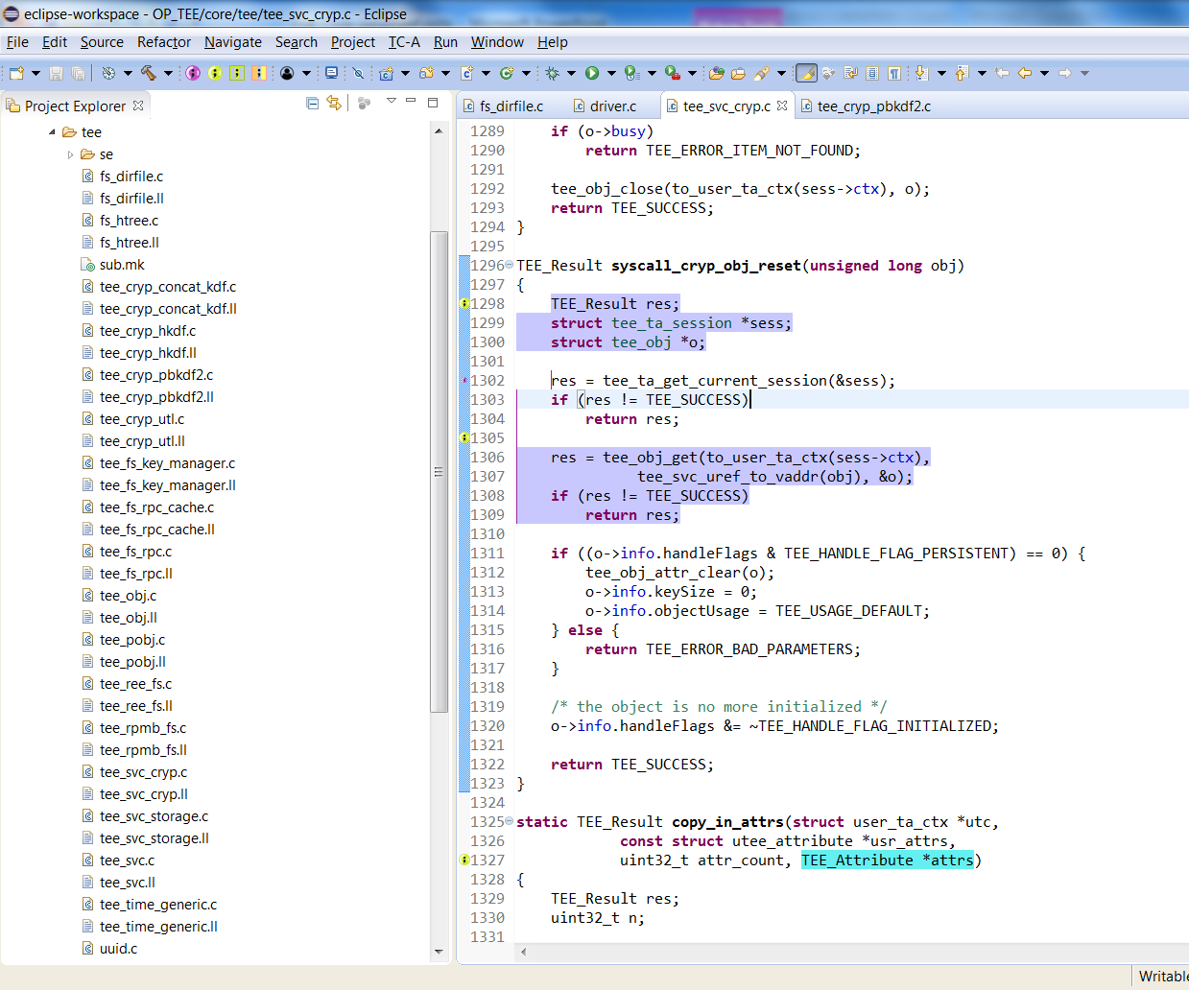
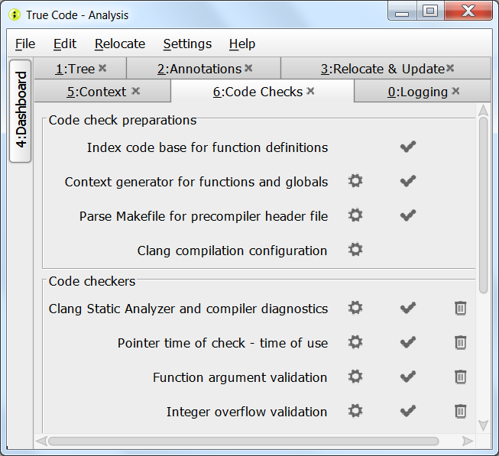
Unique features
Save costs and reduce time to market
True code makes sure that you find vulnerabilities during development. Next to the automated checks that can be executed on a daily bases, True code also facilitates collaboration with security experts in the development phase. Reducing (certification) costs and reach your goals faster.
Fault injection vulnerability checks
Fault injection proves to be a method that used often by attackers. True Code indicates specific vulnerabilities in source code related to fault injection
A pure security product
Many of the static code analysis products out in the market focus on a lot of things that might be of interest for a development team. Not True Code. True code is made for security purposes only with people who have a long track record in code evaluations and excel in security expertise.

Slide 8





Security experts manually check the sources for security vulnerabilities. Found issues are marked and True Code keeps track of sources that have passed review
Use case : collaboration
True code keeps track of code that is developed by the team
;
Developers have an intuitive view on all found issues. Easily can read comments next to feedback on the severity of the issue. All contributing to an efficient mitigation
Security experts can only check the mitigations, new sources and any code that has been changed after being reviewed

Slide 9


Use case : Automation
Security experts configure True Code so that it executing of security checks is tailored to the specific needs of the product
True code keeps track of code that is developed by the team
;
True code is integrated in the continuous development process and automatically evaluates sources on a daily bases. Additional checks can be done by the security team if needed
Developers have an intuitive view on all found issues. Easily can read comments next to feedback on the severity of the issue. All contributing to an efficient mitigation

Slide 10

Riscure B.V.
Frontier Building, Delftechpark 49
2628 XJ Delft
The Netherlands
Phone: +31 15 251 40 90
www.riscure.com
Riscure North America
550 Kearny St., Suite 330
San Francisco, CA 94108 USA
Phone: +1 650 646 99 79
inforequest@riscure.com
Challenge your security
Riscure China
Room 2030-31, No. 989, Changle Road, Shanghai 200031
China
Phone: +86 21 5117 5435
inforcn@riscure.com
Notes:
Note: Insert your picture by clicking on the Picture Place Holder Icon, then send it back!

